Slide 2
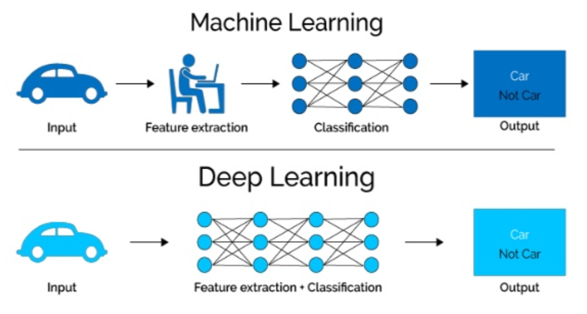
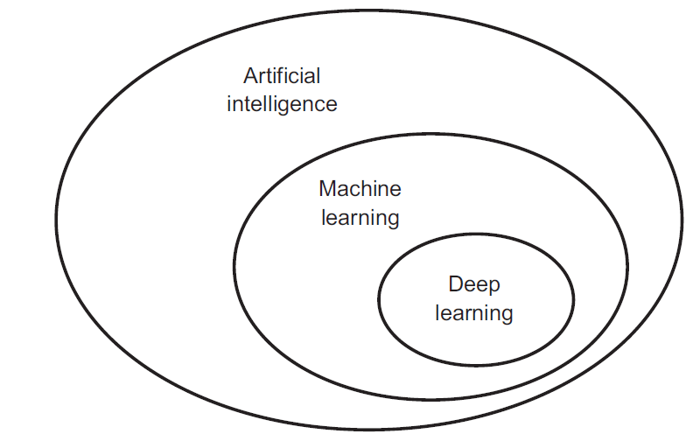
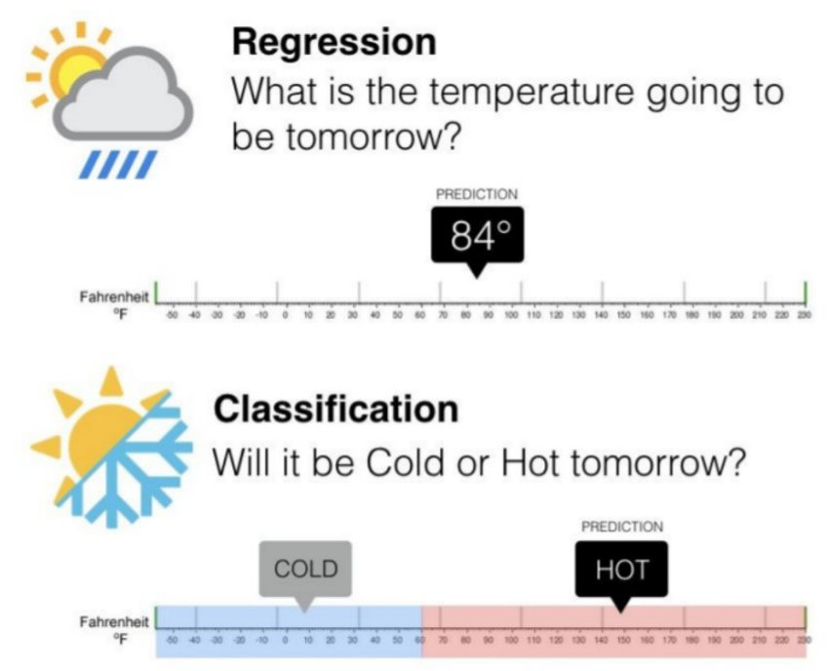
Neural Networks & Deep Learning

Slide 3
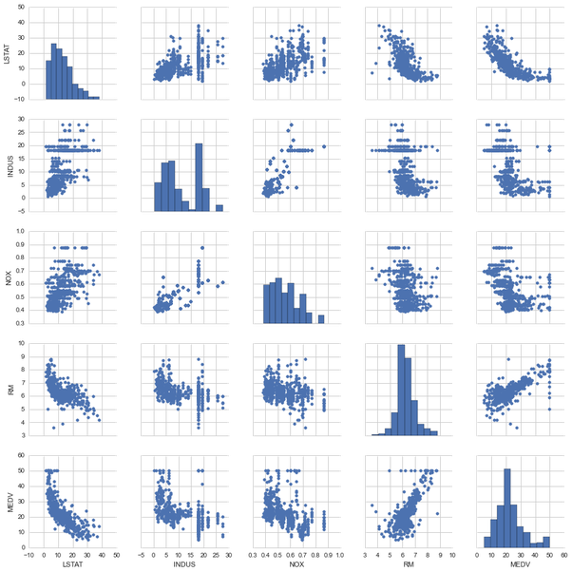
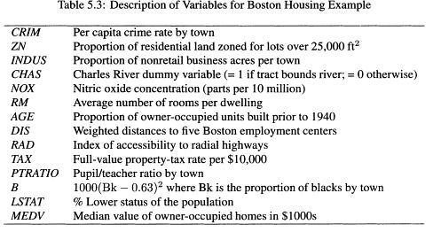
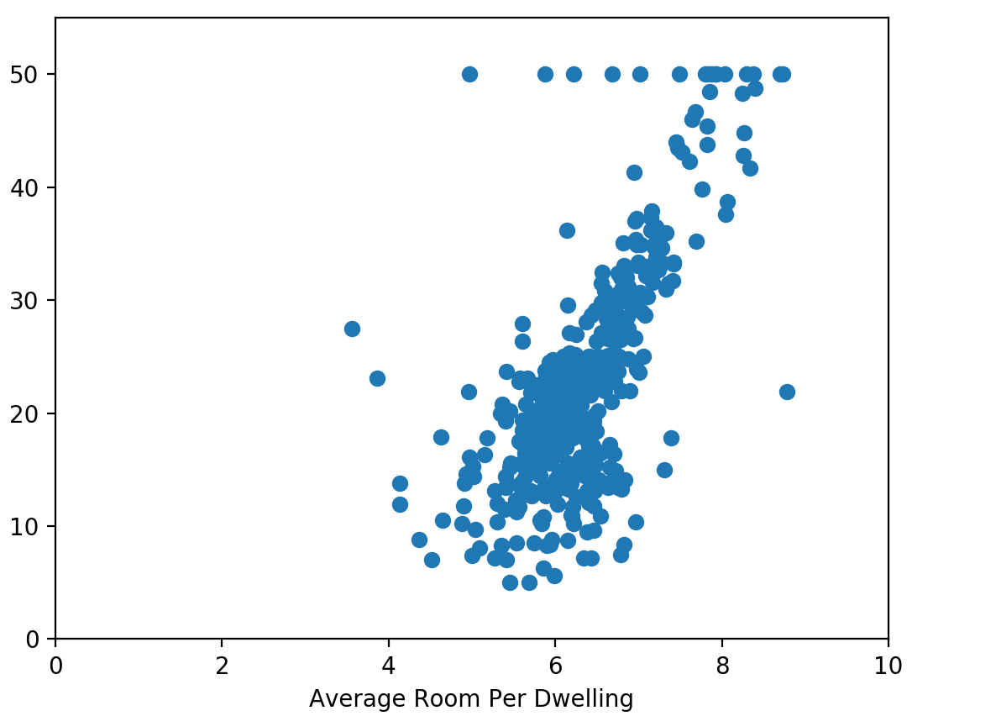
Regression: Boston Housing Dataset

Slide 4
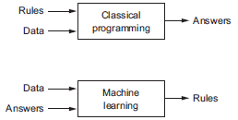
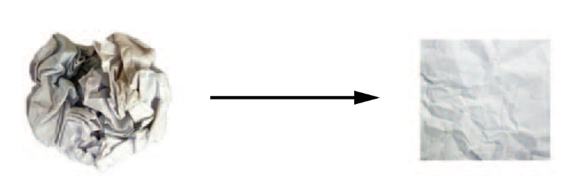
Classification:
Cat detection is a complex task!
Neural Networks try to unfold the complexity

Slide 5
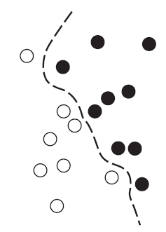

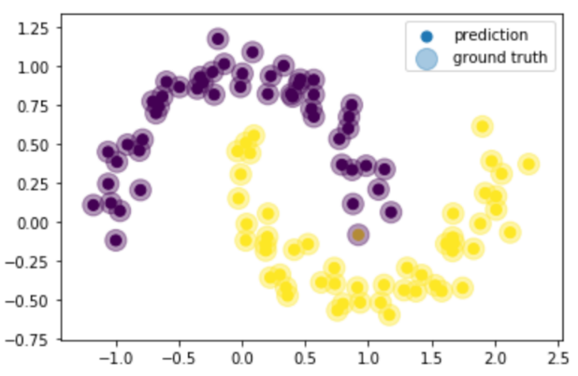
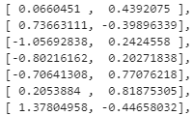
Decision Boundary
Network
Data
Vektor/Matrix
Class decision

Slide 6

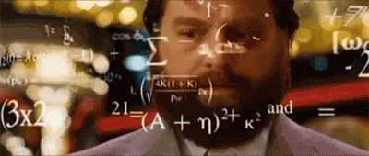
Multilayer Perceptron Loss functions
A loss functions is a grade (Metric) how good we have been doing our task. Mathematicaly speaking, a metric is a measure of „Distance“.
Network Suggestion
1,1,0,1,0
Compare
Ground Truth

Slide 7
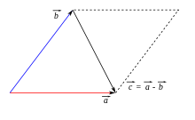
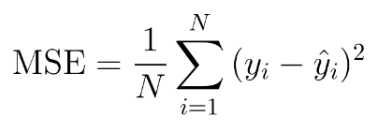
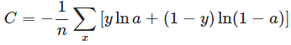
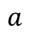
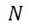
Multilayer Perceptron Loss functions
MSE (Naive approach) Crossentropy
Computes the mean square Error which can defined as the distance of two points in a vector space.
The (mean) cross entropy is a measure of difference between two discrete probability distributions. (created by Claude Shannon)
Ground truth
$$N$$
$$a$$
$$N$$
$$i$$
$$i$$
$$i=1$$
Mean
over all (possible)
classes
Suggestion
Mean
over all (possible)
classes
Ground truth
Suggestion
The naive approach of applying MSE for regression is ok. But (later) we will discuss a reason why classification crossentropy is the way to go in nearly every Situation!

Slide 8
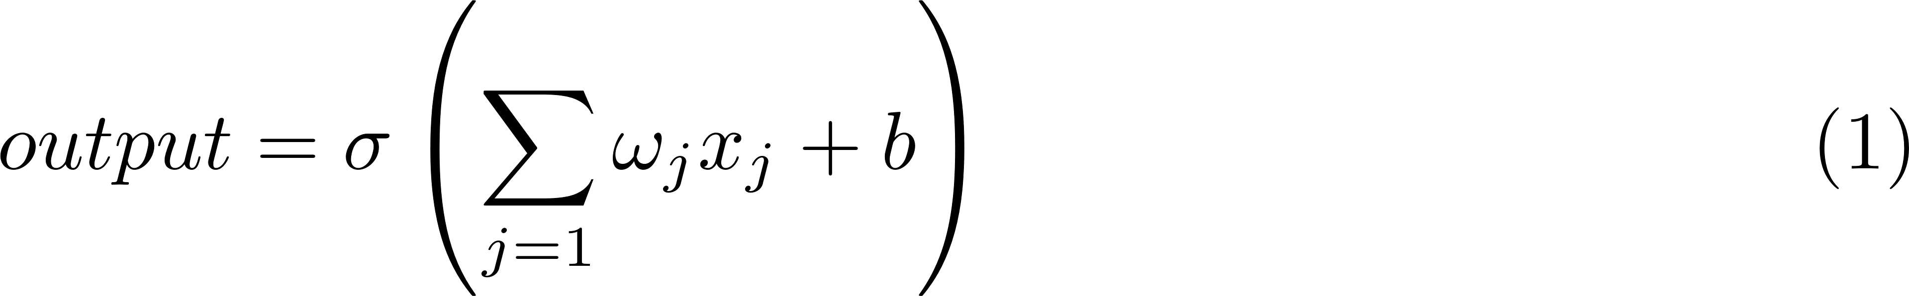
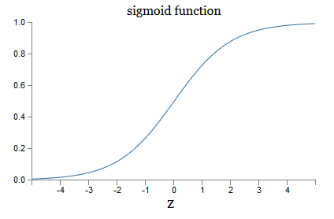
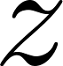
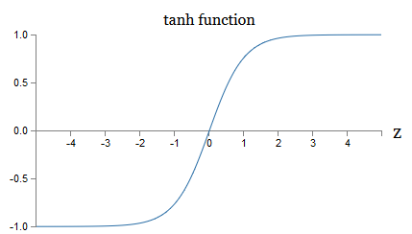
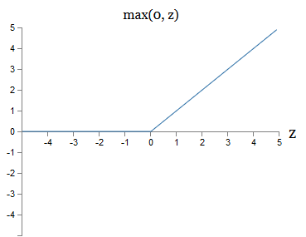
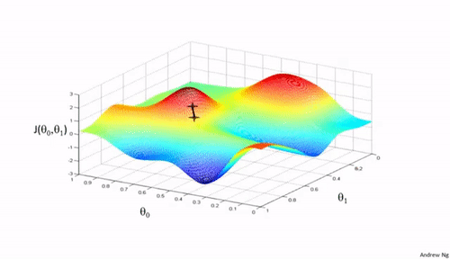
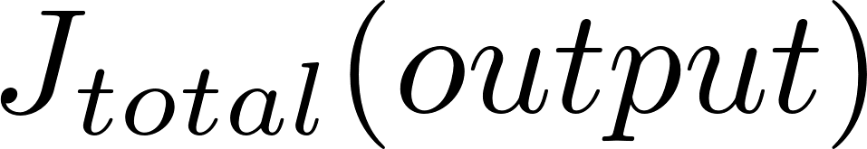
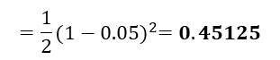
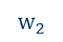
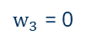
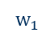
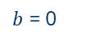
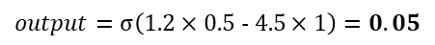

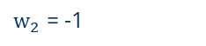


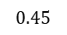
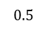

Multilayer Perceptron Forward Pass
Activation functions
$b$ = 0
1.2
$w_{1}$ = 0.5
4.5
$w_{2}$ = -1
1
$$output=σ\left(1.2×0.\text{5 − 4.5}×1\right)=0.05$$
$w_{3}$ = 0
0
$w_{4}$ = 1
Target:
(MSE loss)
2.3
$$=\frac{1}{2}{(1−0.05)}^{2}=0.45125$$
(Relu)
$w_{5}$ = 0
For all weights:
$$0.45$$
$$w_{1}$$
Sum over all training data
$$w_{2}$$
$$0.\text{5}$$
$$w_{1}$$

Slide 9
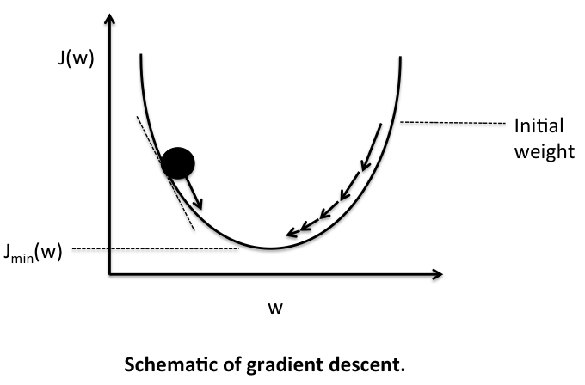
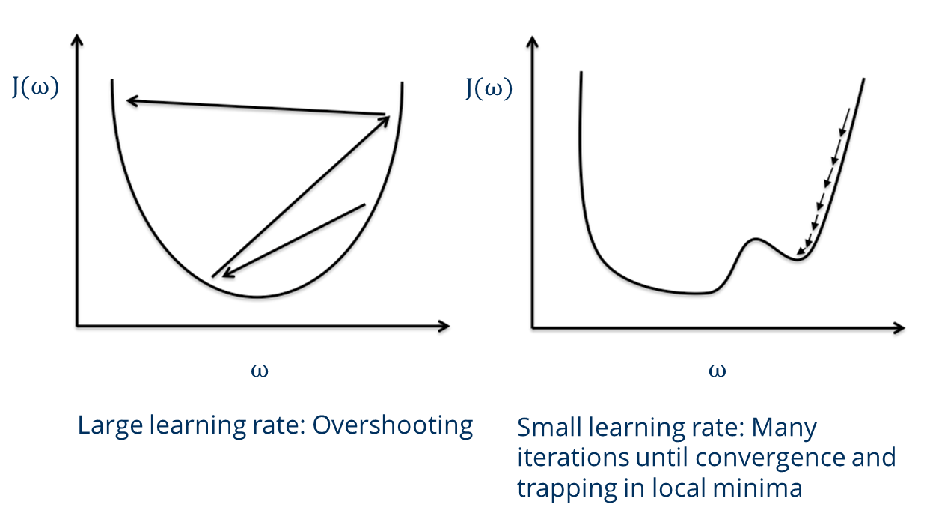
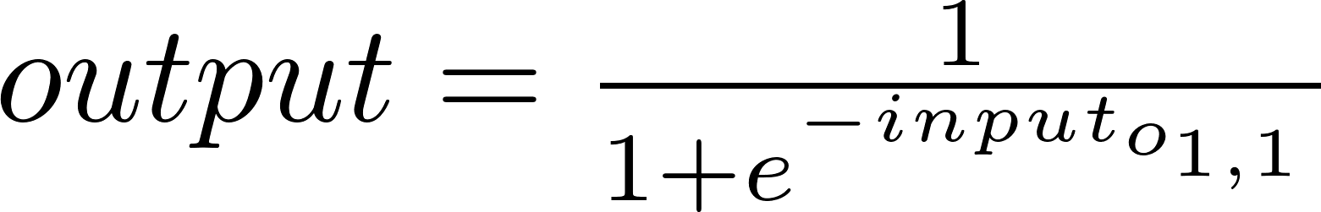

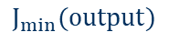
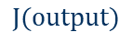
Multilayer Perceptron Backward Pass
$$J(output)$$
Gradien Descent update
$$J_{min}(output)$$
Update rule:
$$ω$$
Learning rate
By chain rule we know for the weights that:
(MMSE Loss)
(Sigmoid)
…

Slide 10
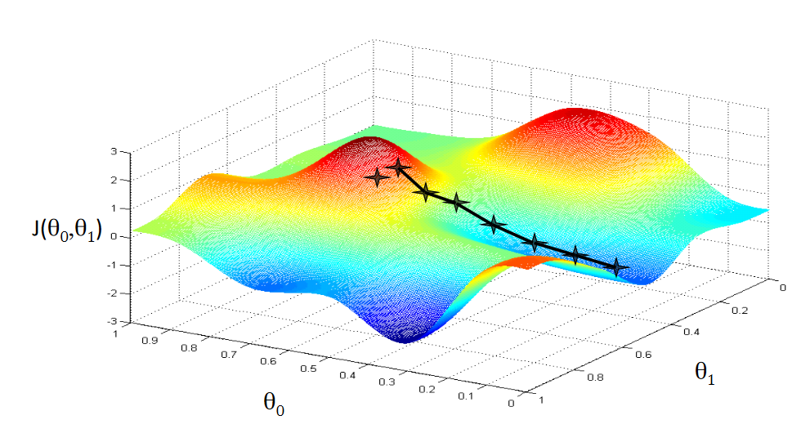
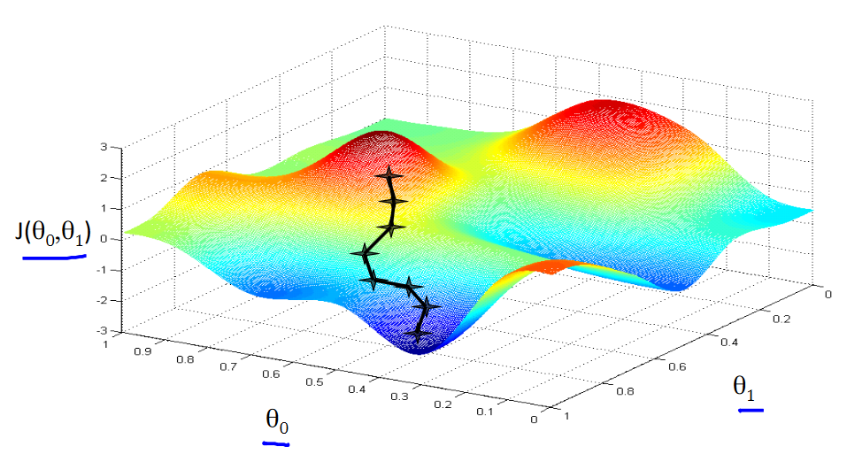
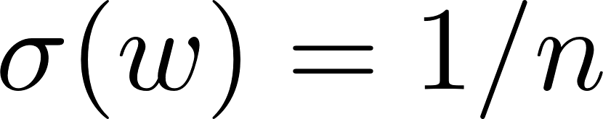
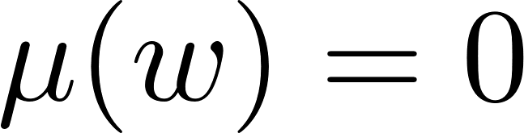
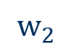



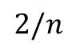
$$w_{2}$$
$$w_{1}$$
$$w_{1}$$
$$w_{2}$$
Initialisation matters!
“Glorot” init:
“He” init (Relu):
$$2/n$$
Bias is set to zero.
n … Number of Neurons

Slide 11
Neuron Saturation
By chain rule we know our knowledge update is:
(Sigmoid)
So if the input of our neuron get‘s very large (Sigmoid & ReLU) or very low (Sigmoid) our gradient will vanish. This is sometimes refered as a „dying neuron“.

Slide 12
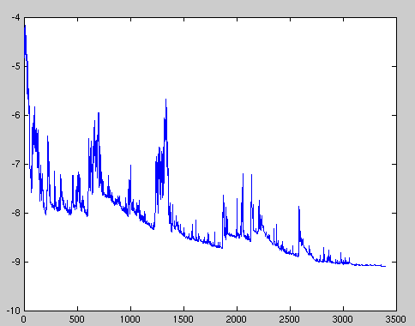

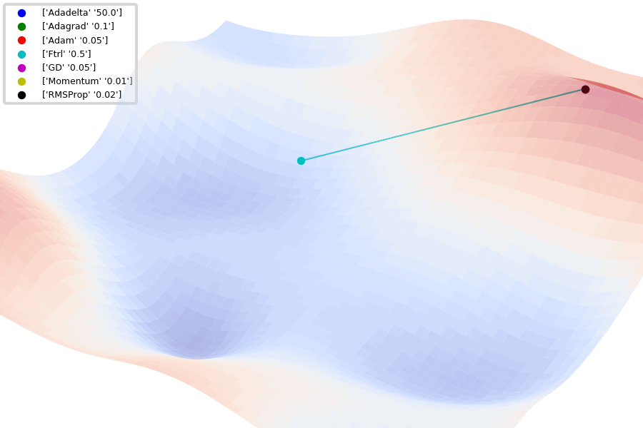
Optimizer – The “learning” Backbone Update rules
Stochastic Gradient Descent (Single-Batch GD)

Slide 13
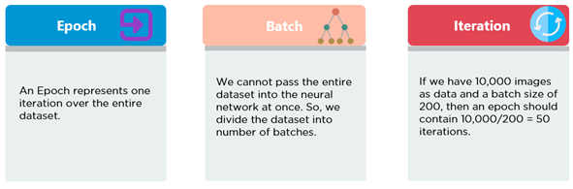
Optimizer – The “learning” Backbone Update rules
Stochastic Gradient Descent (Single-Batch GD)

Slide 14

Multilayer Perceptron Decision Layers
Data
Feature Extraction
Decision Layer
Network output
Class
How to decide which output to print?
There are two possible solutions here.
0.25
10
2
4.02
Cat
Horse
Car
House
Horse!
Argmax(x)
Softmax(x)
(Trained) Cross-entropie loss „x“
Corresbonding Class
(Trained) Log-Loss „x“
Argmax(x)
Class
Softmax(x)
Argmax(Softmax(x))
0.25
10
2
4.02
Cat
Horse
Car
House
0
10
0
0
0.25
10
2
4.02
Cat
Horse
Car
House
0.0105
0.8
0.085
0.1
Horse!
Naive approach. Just take the maximum of the output vector. → Downside: No interpretability
Better: Interpret output as „pseudo“ probability first. The output sums up to 1 now. Then argmax! Typically used together with a Log-loss or Crossentropy

Slide 15
3. Exercise Let‘s train our first classifier from scratch!

